Slide 1
Rail Decarbonization: Overview of FRA Research on Advancing Clean Energy Technologies for Rail
Melissa Shurland
Program Manager, Rolling Stock Research Division
Office of Research, Development, and Technology

Slide 2
Overview of Presentation
Introduction
Background:
Mission of Federal Railroad Administration (FRA)
Overview of Office of Research Development and Technology (RD&T)
Rail Energy, Emissions, and Engine (Rail E3) Technology Research Program
Rail E3 Research Projects
Summary
Questions and Answers

Slide 3
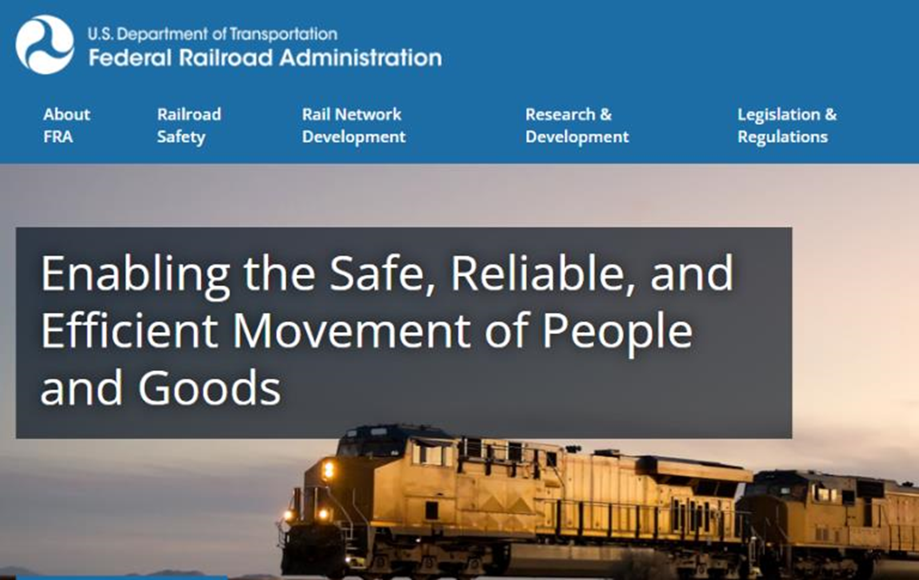
https://railroads.dot.gov/
Notes:
FRA, as US government agency, has a mission to enable the safe, reliable and efficient movement of people and goods.
This mission drives everything that we will talk to you about during this workshop.

Slide 4
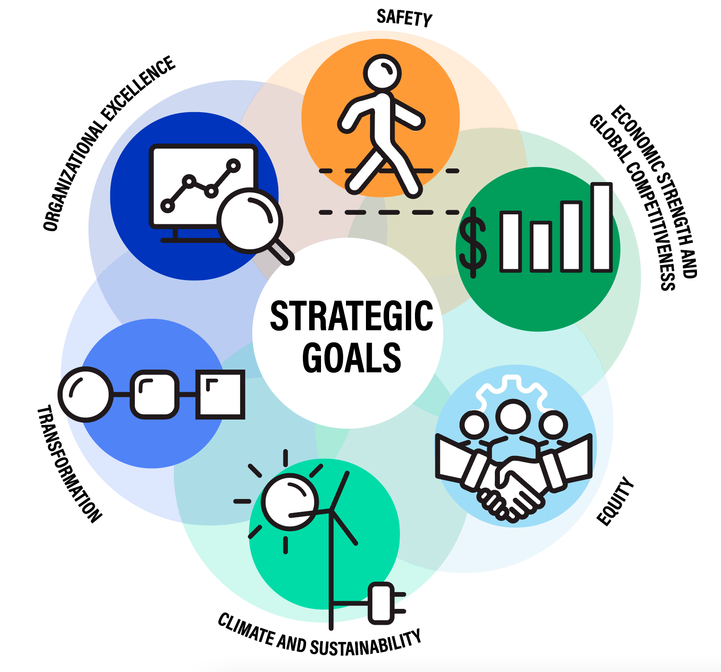
Background – Federal Railroad Administration
Mission
The Federal Railroad Administration (FRA) is an agency within the US Department of Transportation (DOT), whose mission is to enable the safe, reliable, and efficient movement of people and goods for a strong America, now and in the future.
Within FRA, the Office of Research, Development & Technology (RD&T) supports the FRA’s mission through basic and applied research, and development of innovations and solutions.
Safety is DOT’s primary strategic goal and thus, the principal driver of FRA’s RD&T program.
RD&T research also contributes to other DOT strategic goals yielding solutions toward state of good repair, economic competitiveness, environmental sustainability goals, and workforce development

Slide 5
U.S. Greenhouse Gas Emissions by Sector
The Transportation Sector emits more greenhouse gasses than any other U.S. sector.
Rail emits 2.0% of transportation emissions
0.7% of total U.S. emissions.
* Fast Facts on Transportation Greenhouse Gas Emissions | US EPA

Slide 6
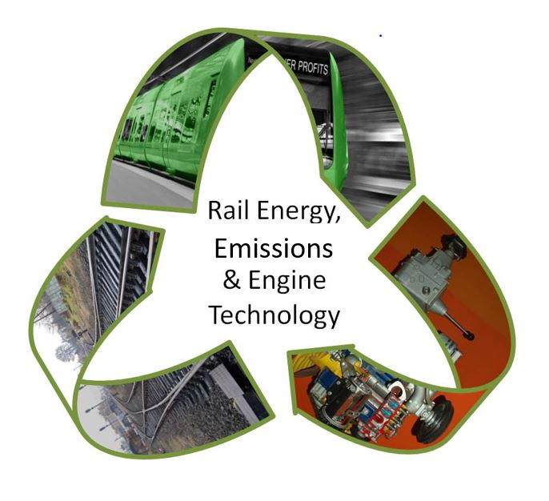
Rail Energy, Emissions, and Engine Technology Research Program
Promote and support the development of safe, efficient, and reliable alternative fuels and motive power for rail transportation.
Develop and demonstrate safe and reliable technologies that reduce the emissions of rail transportation.
Develop knowledge and tools to address climate change and rail infrastructure resiliency.

Slide 7
Rail Decarbonization Technology Research
The state-of-the-art technologies available for decarbonization of rail in the US are:
Hydrogen fuel
Battery energy storage systems
Electrification
Hydrogen and batteries present the next frontier in powering rail transportation:
Reduce rail dependency on fossil fuel
Improve emissions in rail transportation
Current research is focused on supporting the development of these advanced technologies for rail applications, and the assessment of their safe performance.
FRA must ensure such technologies are safe!

Slide 8
FRA Rail E3 Technologies Research Projects

Slide 9
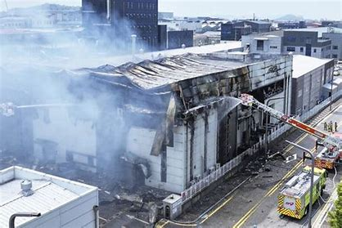
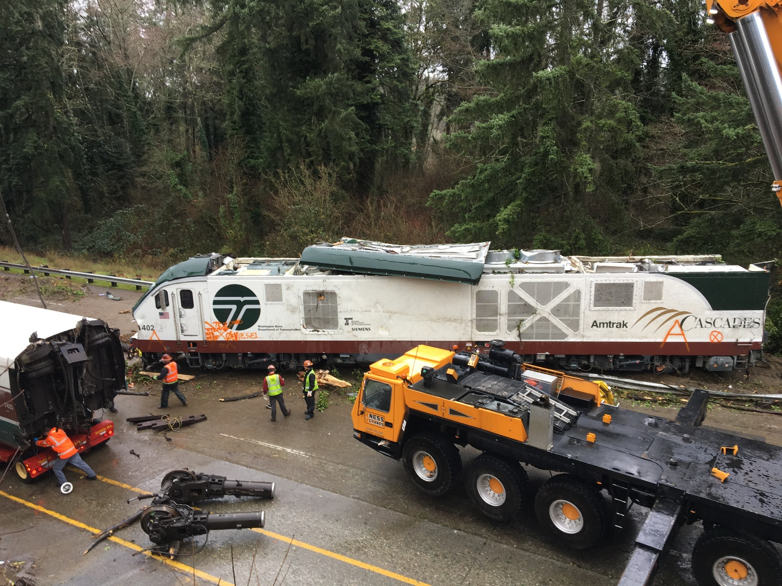
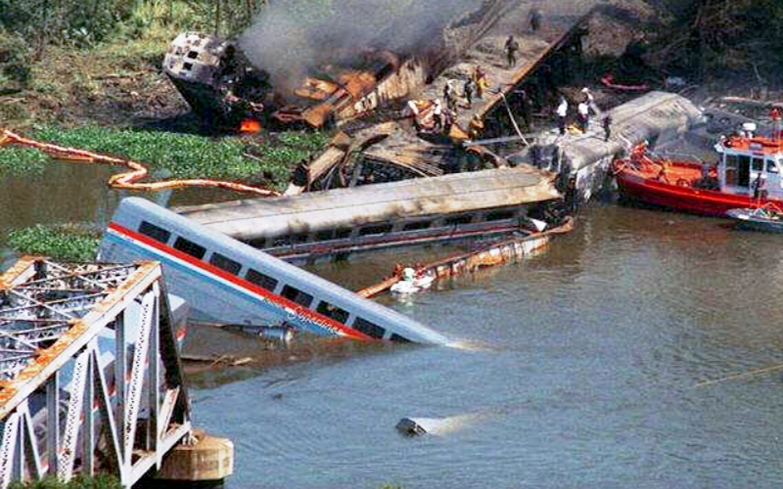
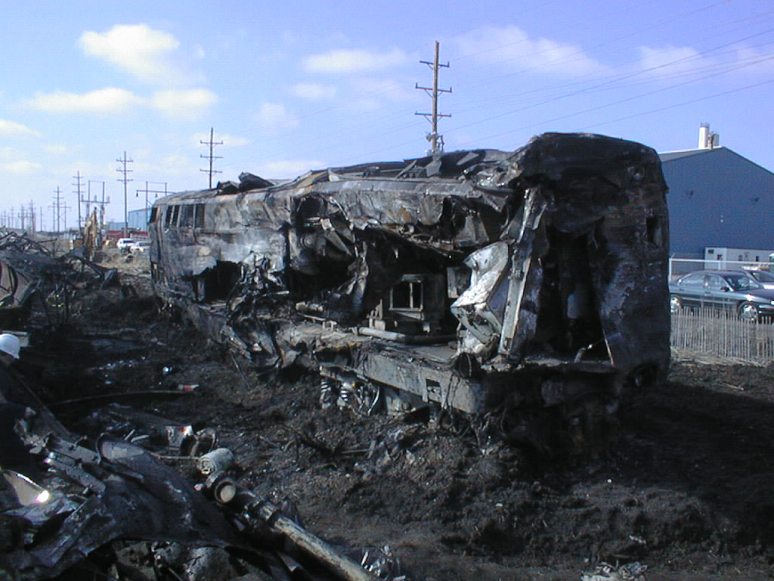
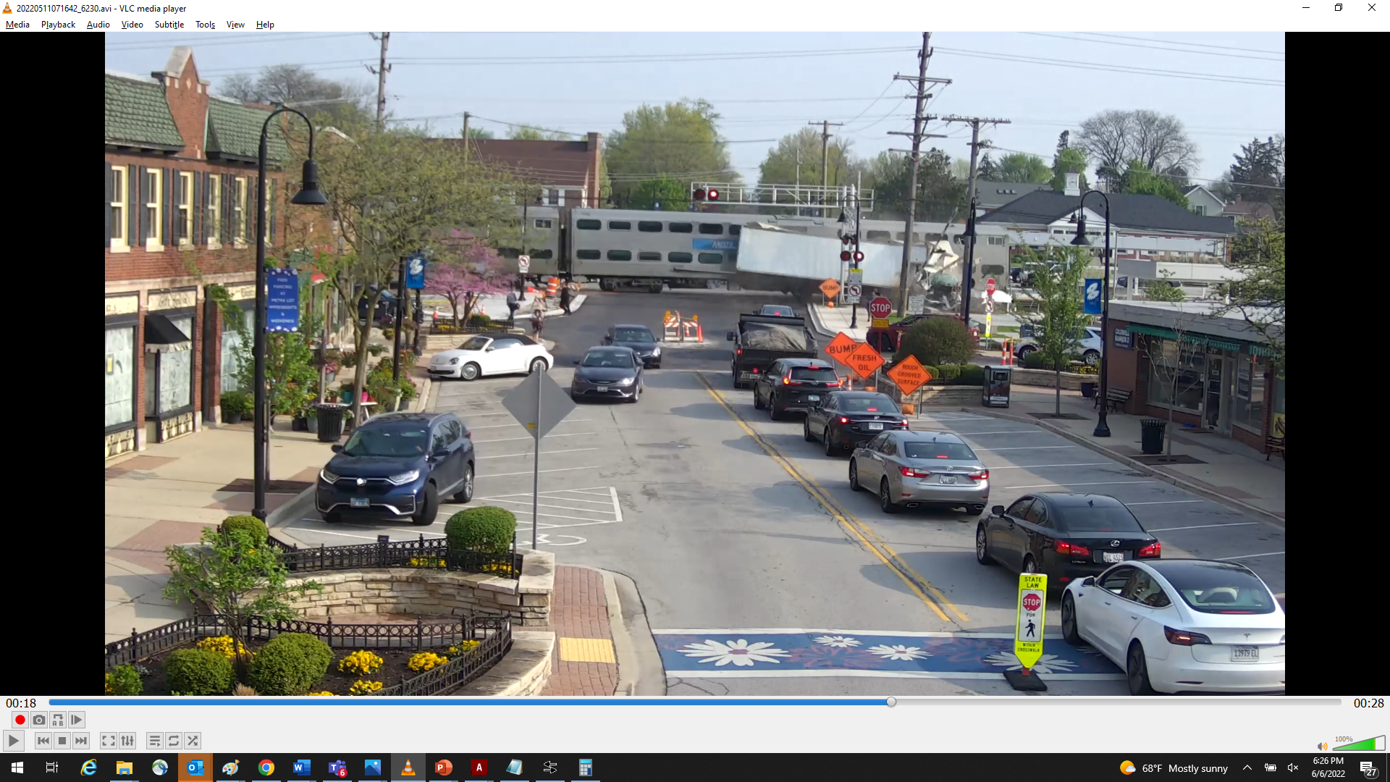

Slide 10
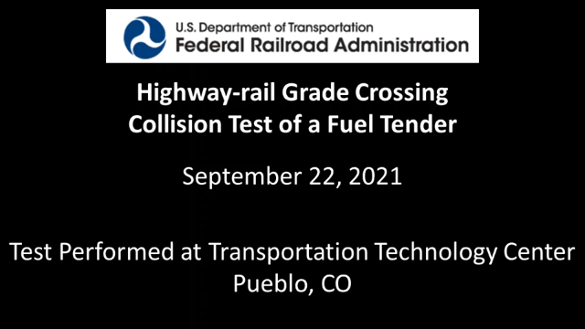
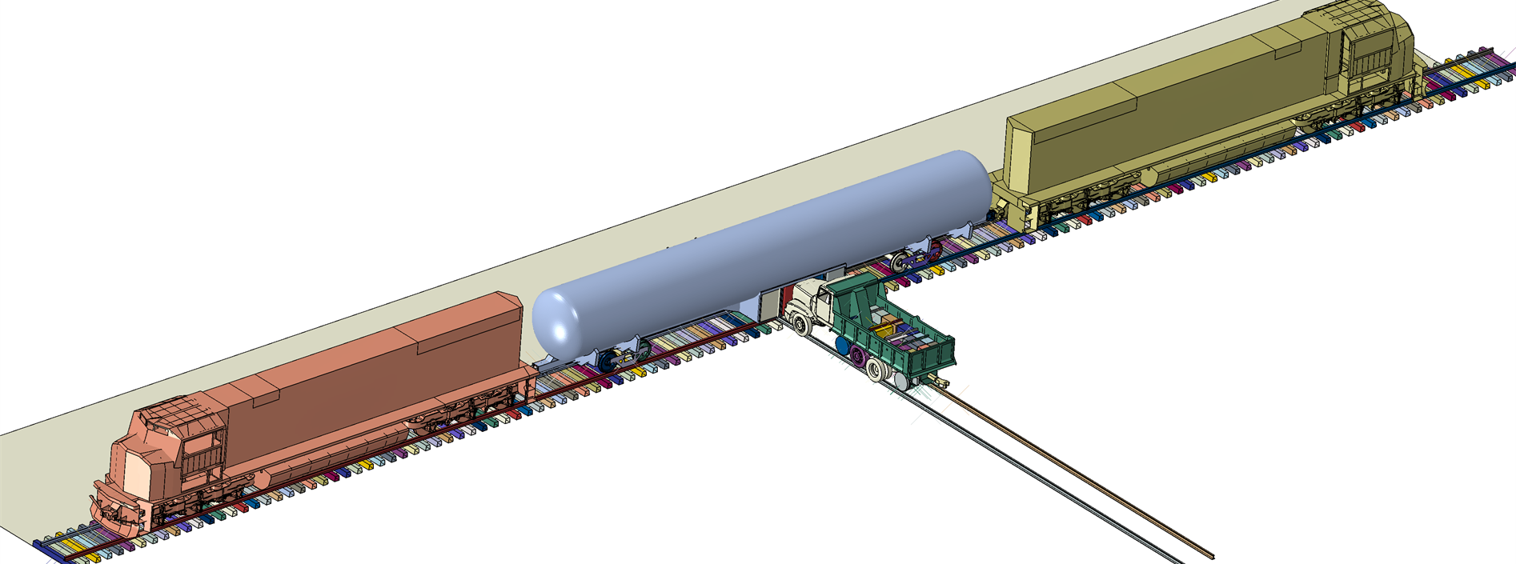
Example of Research Product - Structural Integrity Test of Alternative Fuel Tender
Highway Grade-crossing Collision of liquefied natural gas fuel tender
Fuel tender built to AAR M-1004, Fuel Tenders For Natural Gas and Other Alternate Fuels
80,000lb highway truck at 40 mph into protective housing located on tender, which contained LNG fill valves
Highway Grade Crossing with Descriptions (youtube.com)

Slide 11
Alternative Fuels and Clean Energy Research Activities
Biofuels (2008–Present)
Performance and emissions of biofuels in advanced locomotive engines
Amtrak B20 biodiesel revenue service pilot
B5 to B100 assessment in passenger service
Study of use of bio-based lubricants
Locomotive performance and engine durability of biodiesel use
2008
2010
2019
2021
2023
Battery Locomotive (2010-Present)
Fire safety performance of battery electric locomotive technology
Crashworthiness of battery electric locomotive technology
Expanded capacity of batteries
Charging strategies and technology development
Feasibility Study of Battery in Rail Application
Support the development of NS 999 battery electric locomotive
Hydrogen and Fuel Cells (2019-Present)
Hydrogen dual fuel engine development
Assessment of post-crash outcomes for rail
Operations and maintenance requirements for hydrogen fueled rail vehicles
Fuel tender requirements for hydrogen-fueled rail vehicles
Fires and safety of hydrogen fueled rail vehicles
Crashworthiness of hydrogen fueled rail vehicles
Impact figures of merits of hydrogen technology in rail
Notes:
Biofuels Research
Since 2008 FRA has engaged in alternative fuel research. It started with feasibility study of biodiesel in an Amtrak train in revenue service. Followed by performance of tier 1 and 2 locomotive engines on various blends of biodiesel from 5% biodiesel blended with diesel to 50% blend. The biodiesel research in the past decade was done in cooperation with the railroads. Currently, FRA is working with locomotive OEM, DOE and national lab to evaluate various blends of biodiesel and renewable diesel in Tier 4 Progress Rail engine. Research is focus on changes in performance and emissions with increasing blends. Results will be fed to Progress Rail for improvement in their locomotive engines.
Hydrogen Fuel Safety
Research on this technology began in 2019 with DOE and Sandia National Lab. The initial research investigated which sector of the rail industry makes the most sense for H2: commuter rail, yard switching and short distance regional operations are best suited H2. We are investigating the risks surrounding release of H2 following a collision or derailment: immediate release of H2, no release of H2, delayed release of H2, and subsequent resulting actions. FRA is working with Wabtec on the development of an internal combustion engine that will burn a blend of H2 and diesel fuel. The research is focused on varying the blend of H2 to diesel fuel and recording the engine performance, and emissions reduction. FRA is also working with Ensco to possibly conduct an impact test similar to the LNG impact test from 2021 of a mock-up of a powerpack consisting of H2 cylinders and fuel cells as currently designed for passenger trainsets.
Battery Electric Locomotive
FRA worked closely with NS Corp between 2010 – 2014 in development of their battery electric locomotive. Current research is focused on understanding the fire safety and toxicity of battery electric locomotives. Tests at TTC are also being considered to assess the performance of the batteries under heavy loads as can be experienced during rail accidents.

Slide 12
Summary
Research is necessary to maintain a safety and efficient rail network in the US:
Investigate safety issues.
Develop new techniques to mitigate risks.
Develop new technologies to advance the state-of-the-art in rolling stock, track, human factors, and train control and communication.
Research is collaborative!

Slide 13
Thank You
Any Questions?

Slide 14
Melissa Shurland
Program Manager
Rail Energy, Emissions, and Engine Technologies Research
Office of Research, Data, and Innovation
Melissa.Shurland@dot.gov

